Slide 1

Web Development Workshop
HTML & CSS
Notes:
‹#›

Slide 2
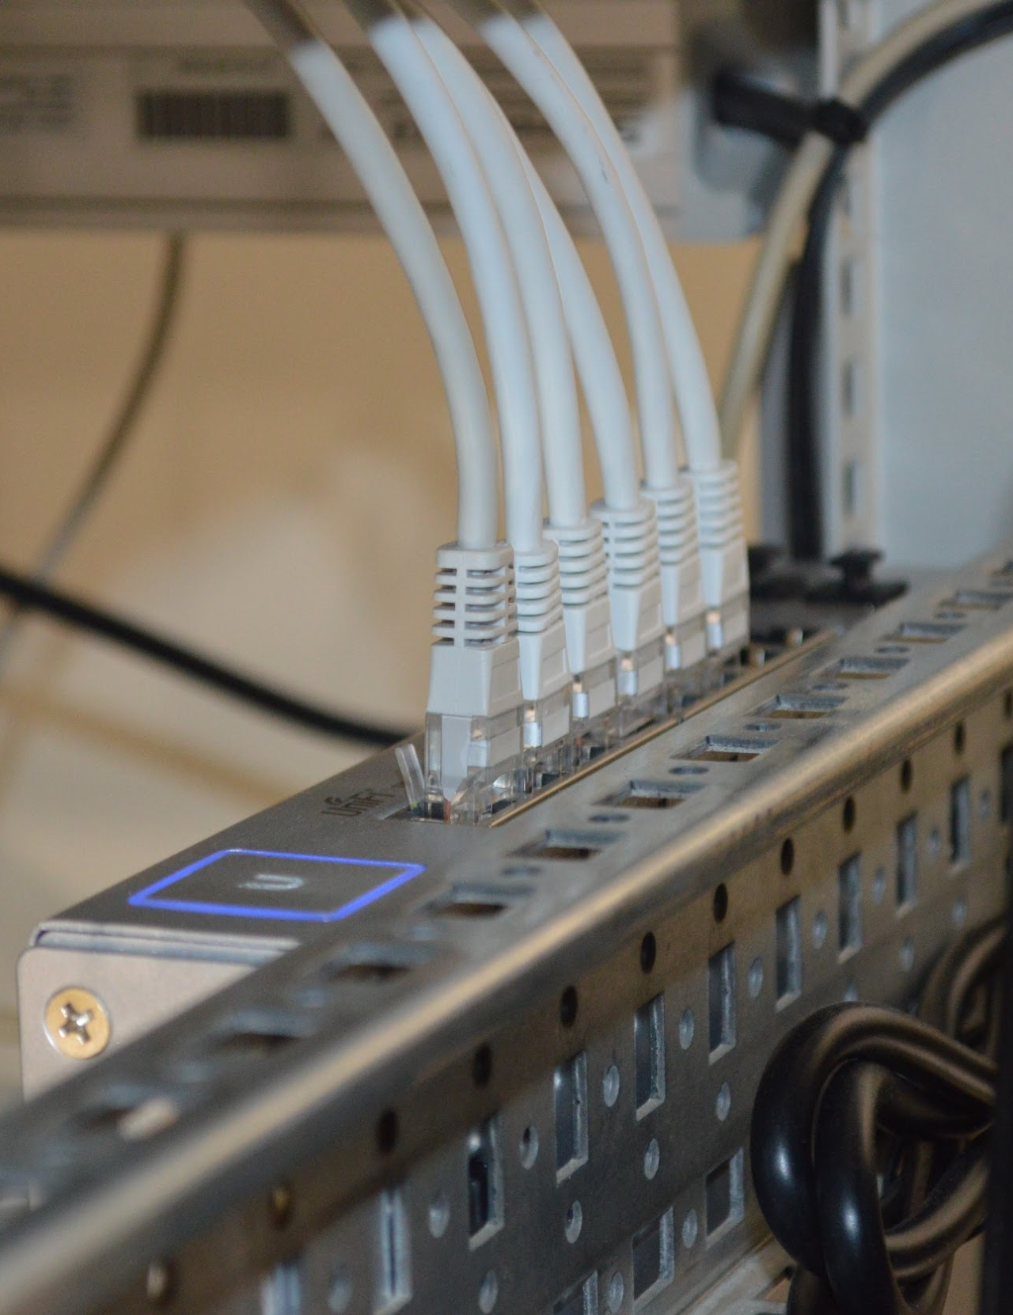
Agenda
Theory Session
Hands-On Session
Host your Web Page Online!
JOHN DOE
CEO

Slide 3
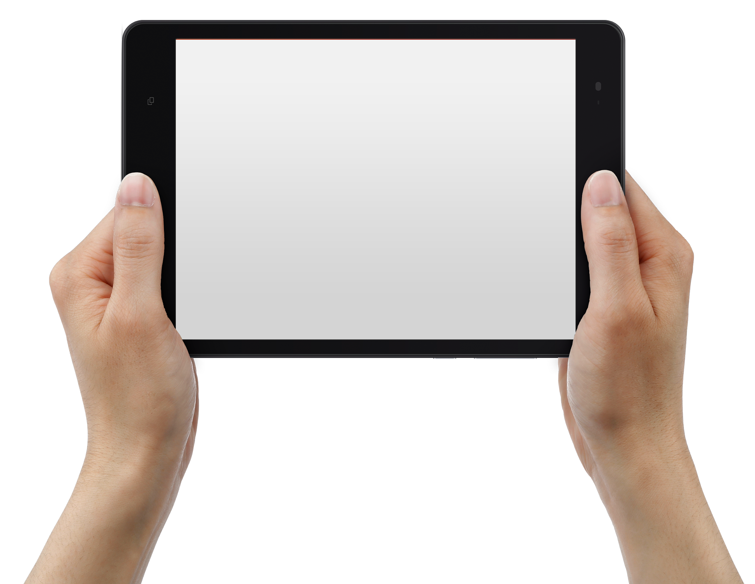

Web Basics
What is Website?
Collection of Web Pages. First page of any website is
called home ge for that site.
What is Web Server?
A Place from where the website is hosted..
Each web server is given a unique address known as
IP Address. eg. for google.com it’s 172.217.160.206
What is Web Browser?
To access the Web you need a web browsers, such
as Chrome Microsoft Edge or Mozilla Firefox.

Slide 4

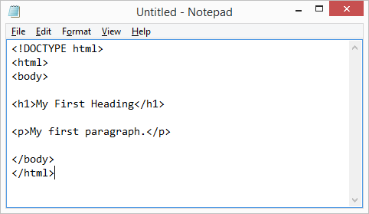
HTML
Is HTML a programming language ?

Slide 5
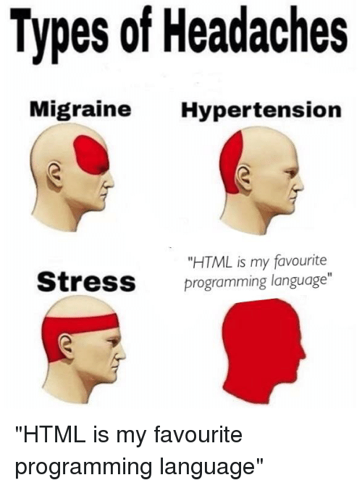

Slide 6
What Happens when you type google.com in search bar?
Notes:
‹#›

Slide 7
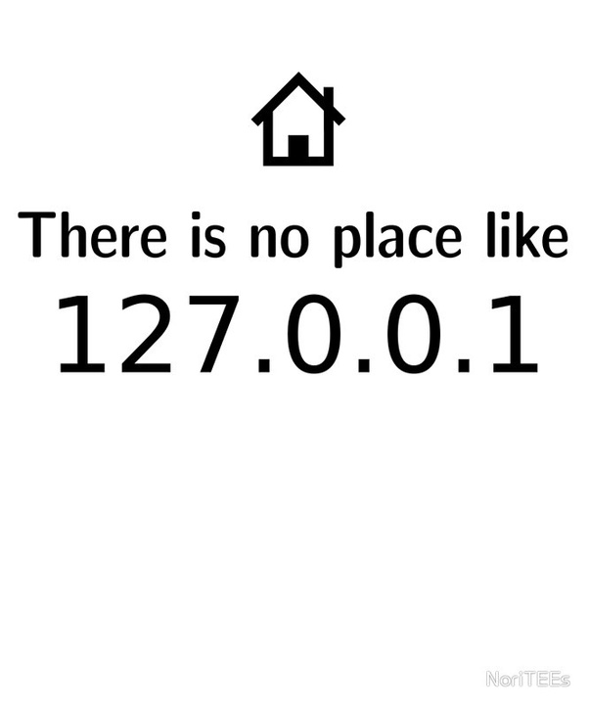
Computer and other devices communicate using ip addresses to identify each other on the internet.
209.85.129.103
192.228.29.1
74.125.77.106
147.67.119.102
142.236.154.112
92.123.122.103
193.252.122.103

Slide 8
People Don’t Remember IP Addresses So They Use Words
www.google.com
www.acm.org
www.pict.acm.org
www.pictoreal.in
www.pict.edu
www.prevue.tech
www.qwerty.com
localhost

Slide 9
The Domain Name System Brings in the two together and gets you to your destination
209.85.129.103
192.228.29.1
74.125.77.106
147.67.119.102
142.236.154.112
92.123.122.103
193.252.122.103
www.google.com
www.acm.org
www.pict.acm.org
www.pictoreal.in
www.pict.edu
www.prevue.tech
www.qwerty.com

Slide 10
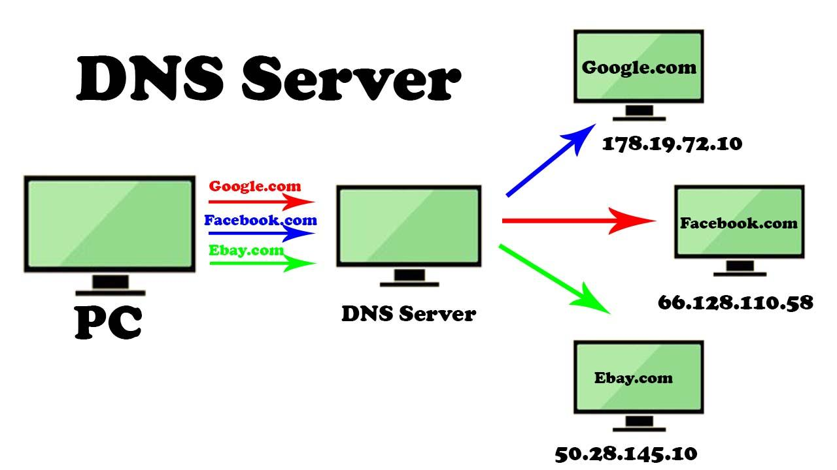

Slide 11
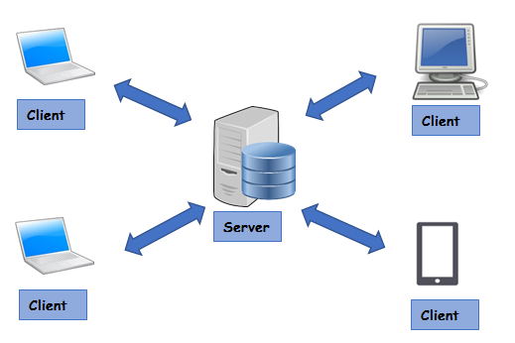
The client-server Architecture
Server -
Server is a computer which hosts or serves the website.
It has all the data of the website.
Client
Clients are the devices which connect to
the server , i.e. visit the website.
Client can be any device like PC, laptop,
mobile, etc

Slide 12
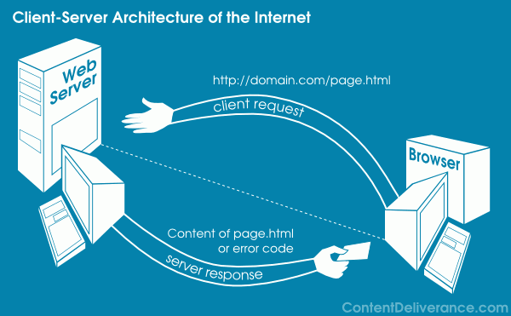
The client-server Architecture
What exactly happens when you
access a website?
Your browser sends a request to the website
server, e.g. http://domain.com/page.html.
Server processes the request, i.e. reads the
requested webpage (page.html here).
Now, server sends this page as a response
to the client.
If something goes wrong, server sends the respective error.
Your browser reads the response and renders the page sent by server, which you see on the screen.

Slide 13
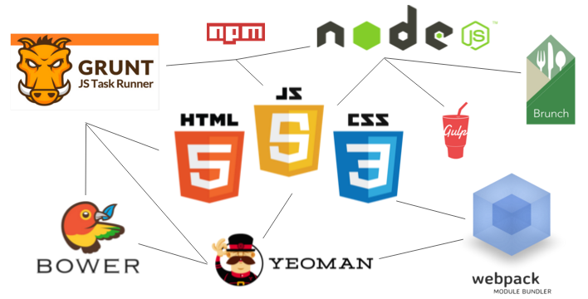
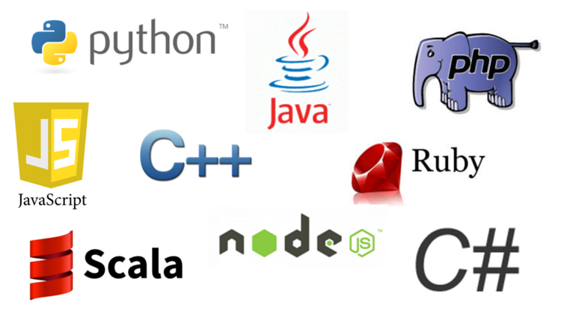
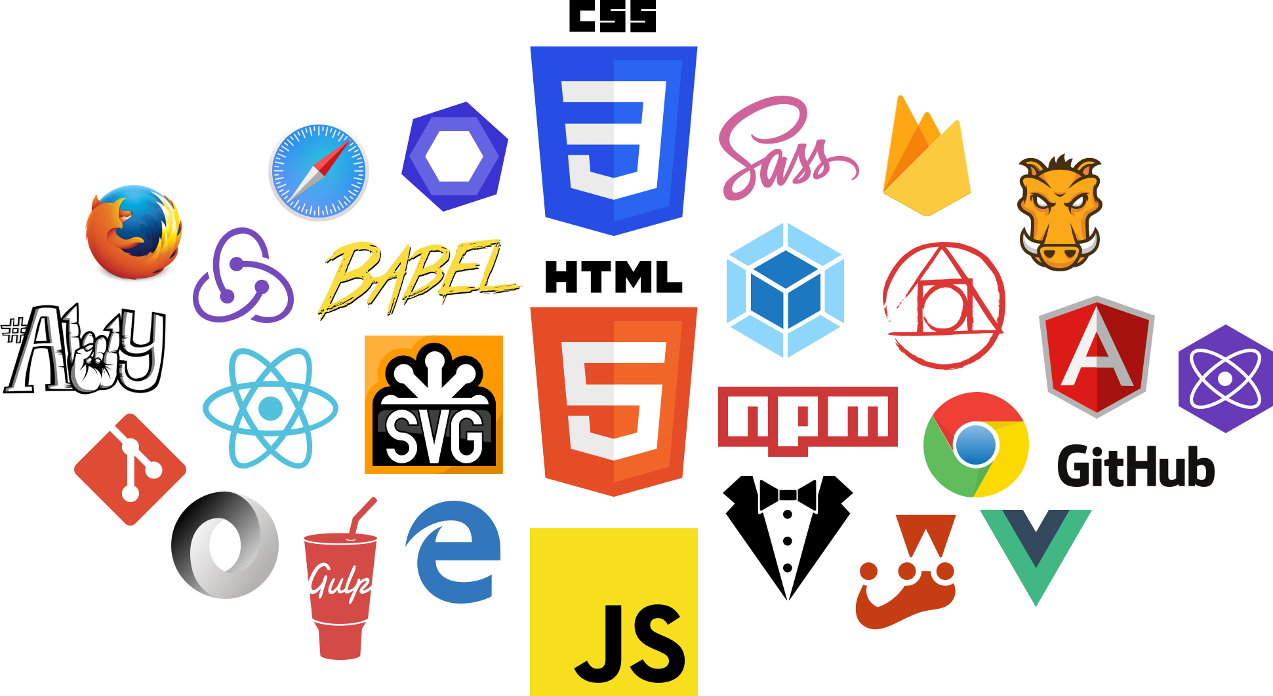
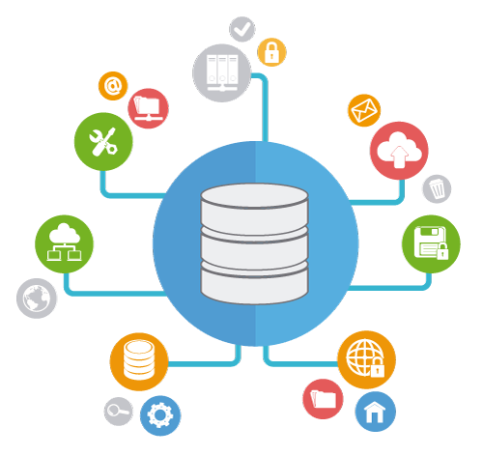
Web Development
Frontend Dev.
Backend Dev.
Database

Slide 14







Frontend
The front-end is everything involved with what the user sees and interacts with. It includes graphical design, aesthetics, interaction with user.
HTML - Basic markup language for webpages
CSS - Adds styles to basic webpages
Javascript - Adds logic and interaction to webpage

Slide 15





Backend
The back-end is server-side development.
It is the term used for the behind-the-scenes activities, i.e. the data processing and the logic performed to respond with the appropriate information as requested by the user.
Performs actions like logging in a user, display information from database, etc

Slide 16




Database
Database is a systematic collection of data. Databases support storage and manipulation of data and makes data management easy.

Slide 17


Ohh wait, did you think that’s all?
These days, web development is a lot more than just the websites! Using Javascript frameworks like electronJS, React native, etc you can even develop Desktop, Android and iOS apps just using HTML, CSS and JS!

Slide 18
Finally!
HTML & CSS Hands-on is here

